Slide 1
The Precipitable Water Project:
Using Zenith Clear Sky Temperature to Approximate Precipitable Water in Areas without Nearby Measurements in the Western U.S. Vicki Kelsey¹²³
¹Langmuir Laboratory for Atmospheric Research ²South Dakota School of Mines and Technology
³National Weather Service ABQ Student Volunteer Summer 2021 vkelsey@pmat.app
2 April 2022 5th Texas Weather Conference

Slide 2
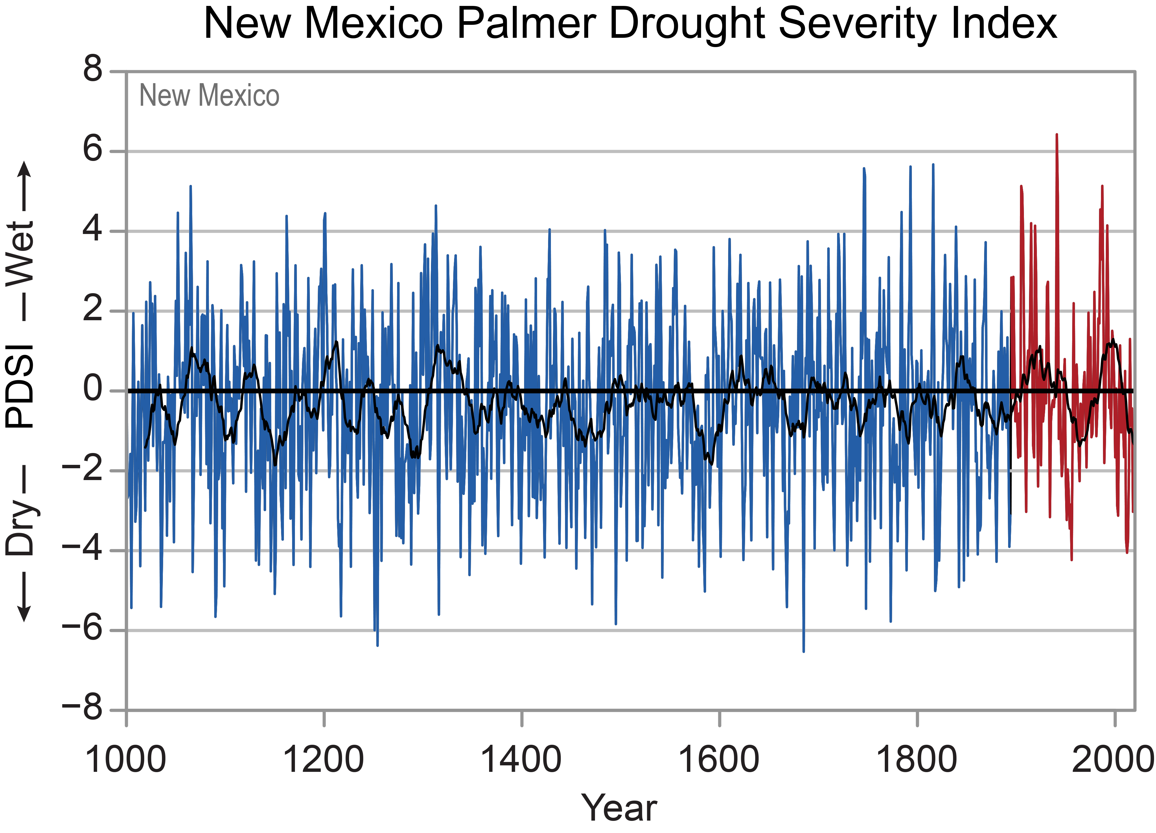
PWAT: Drought to Deluge
This project shows how zenith clear sky temperatures can be used to approximate PWAT in higher elevation, arid and semi-arid regions of the west where data is not currently available for forecasting
Image: https://statesummaries.ncics.org/chapter/nm/

Slide 3
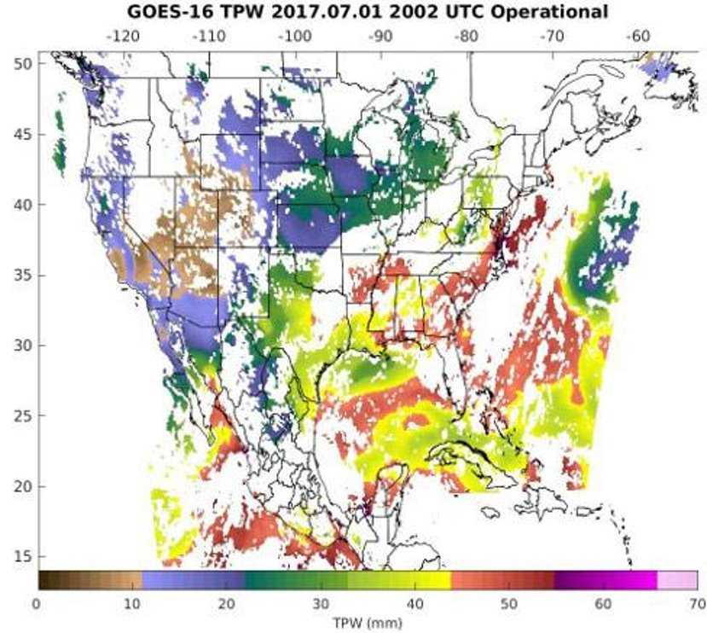
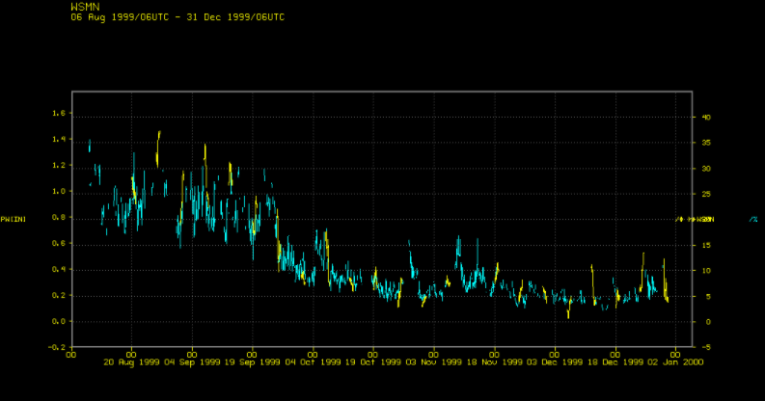
PWAT Data Gaps
GOES-R limitations
- Angle of incidence
- Topography
POES limitations
- Orbits
- Frequency
GPS measurements and Ground based
monitoring equipment
- Few measurement sites
- Funding
- Elevation
Radiosondes
- Large WFO areas
- Large distances between sites
image from: https://www.goes-r.gov/products/baseline-total-precipitable-water.html
Image: https://www.ssec.wisc.edu/~scottl/calval/whitesands.html
image from: https://www.goes-r.gov/products/baseline-total-precipitable-water.html

Slide 4
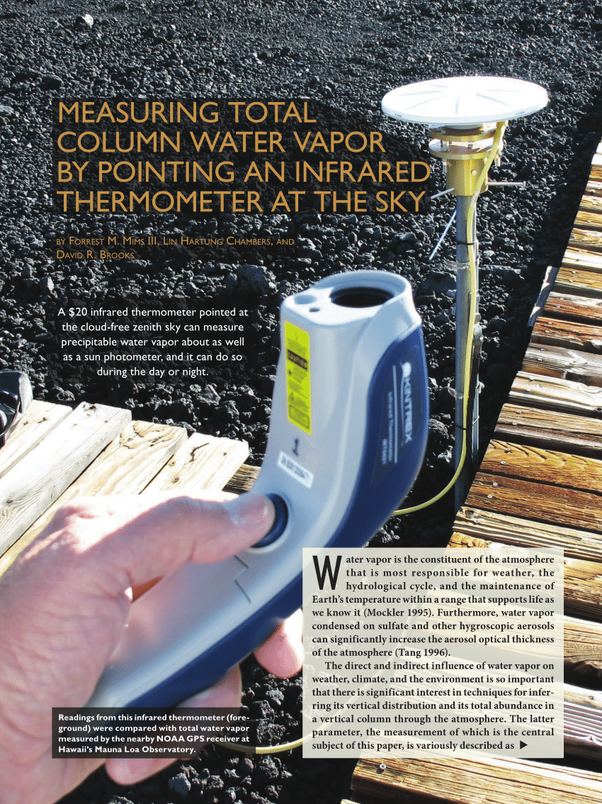
Previous Works
Smith and Toumi. 2008
London, UK
Maghrabi and Clay. 2009
Coastal South Australia
Mims et al. 2011
Seguin, Texas
Image: Bulletin of the American Meteorological Society, 92(10), 1311-1320. https://journals.ametsoc.org/view/journals/bams/92/10/2011bams3215_1.xml

Slide 5
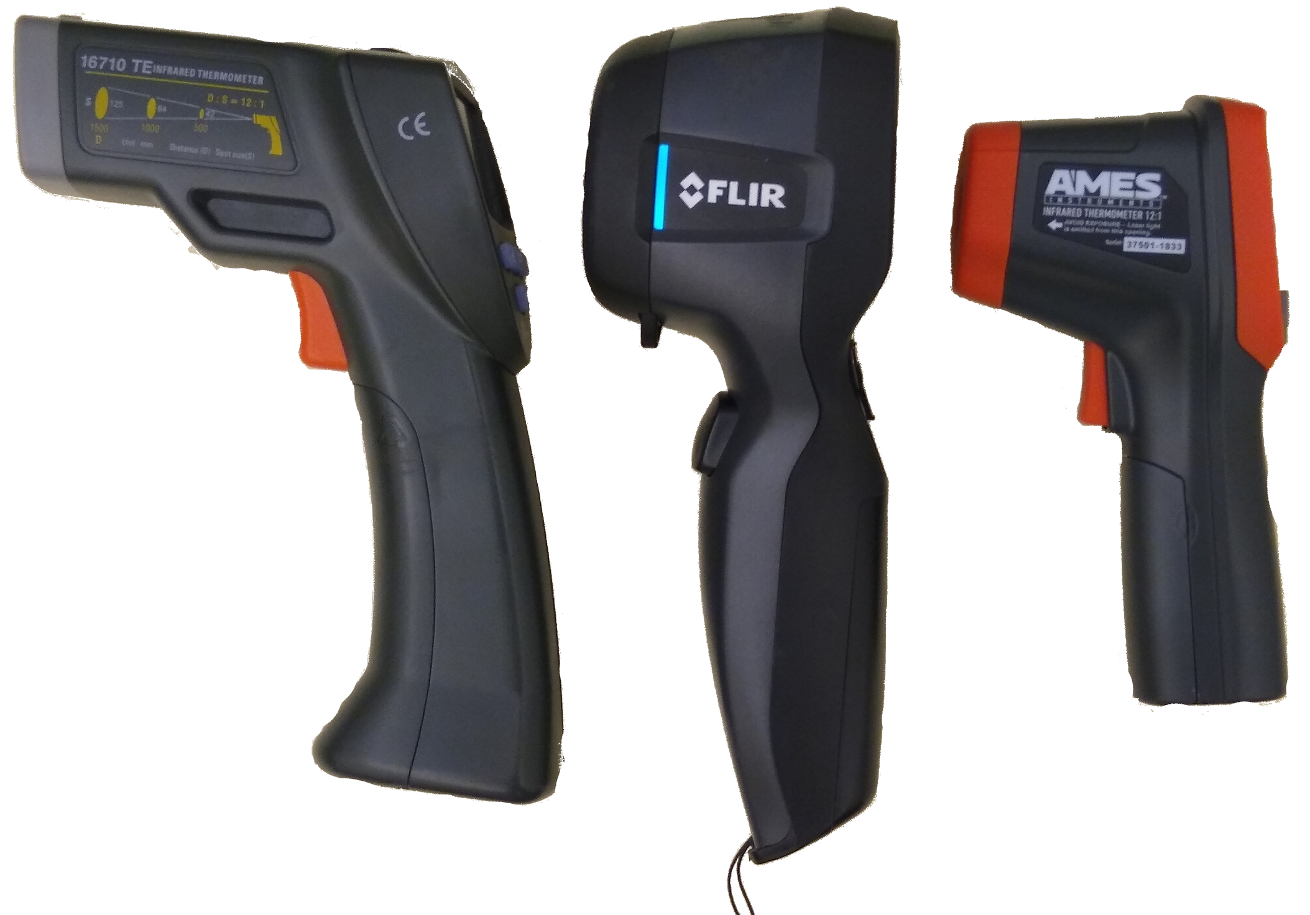
Instrumentation
TE 1610
Field of view: 4.8° Cone
low temperature limit: -20°C
Target emissivity: 0.95
FLIR i3
Field of view: 12.5° x 12.5° Rectangle
Low temperature limit: -40°C
Target emissivity: 0.95
AMES 12:1
Field of view: 4.8° Cone
Low temperature limit: -50°C
Target emissivity: 0.95
Image taken by Spencer Riley

Slide 6
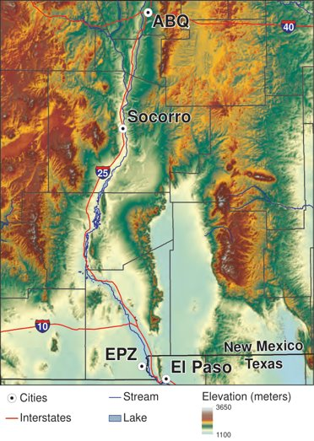
Methodology
Daily zenith sky temperature measurements
- Started January 2019, Socorro, NM
- 1700-1800 UTC or 2300-2400 UTC
- Designation of either cloudy or clear sky
- Ground Temperature measurements taken to
check for calibration and drift
Compare zenith clear sky temperatures with PWAT measurements
- Radiosondes from ABQ and EPZ WFOs
- SuomiNet data (when available)
- AERONET data (when available)
Map created by Phil L. Miller, Map Production Coordinator, New Mexico Bureau of Geology and Mineral Resources

Slide 7
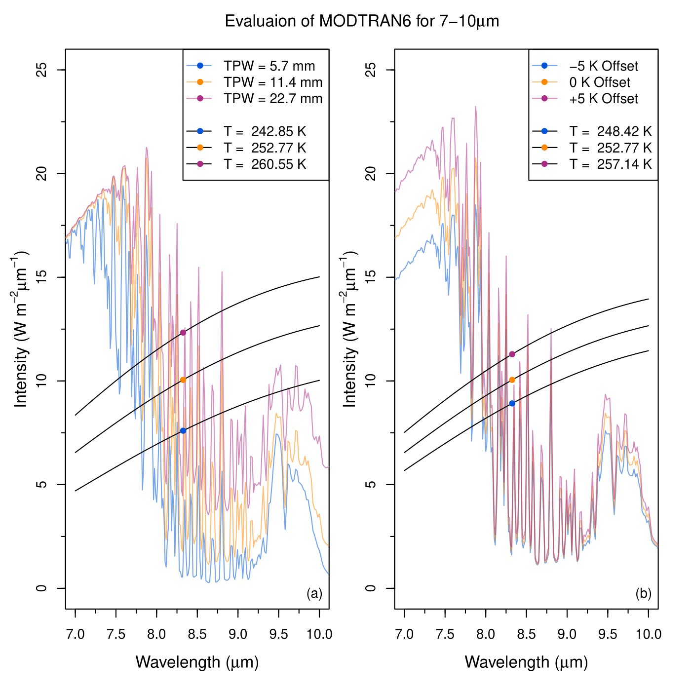
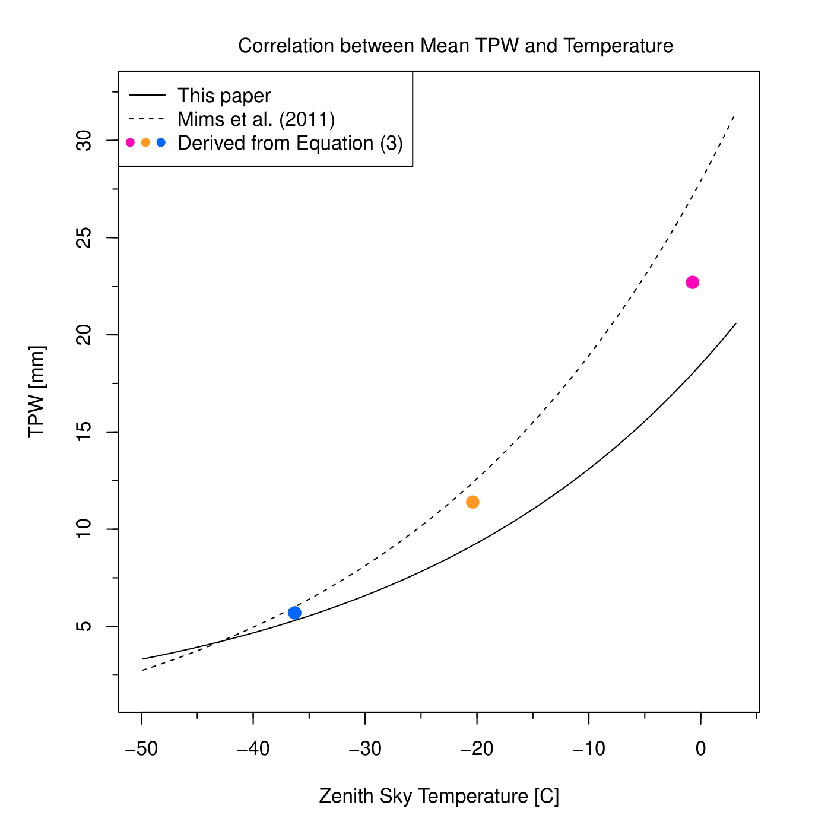
Checking our data against MODTRAN6 and Mims et al.
Zenith Sky Temperature matches Brightness Temperature data from MODTRAN6
Planck function evaluated
Our fit more in line with MODTRAN6 points than Mims et al. achieved
(Kelsey et al., 2022)
(Kelsey et al., 2022)

Slide 8
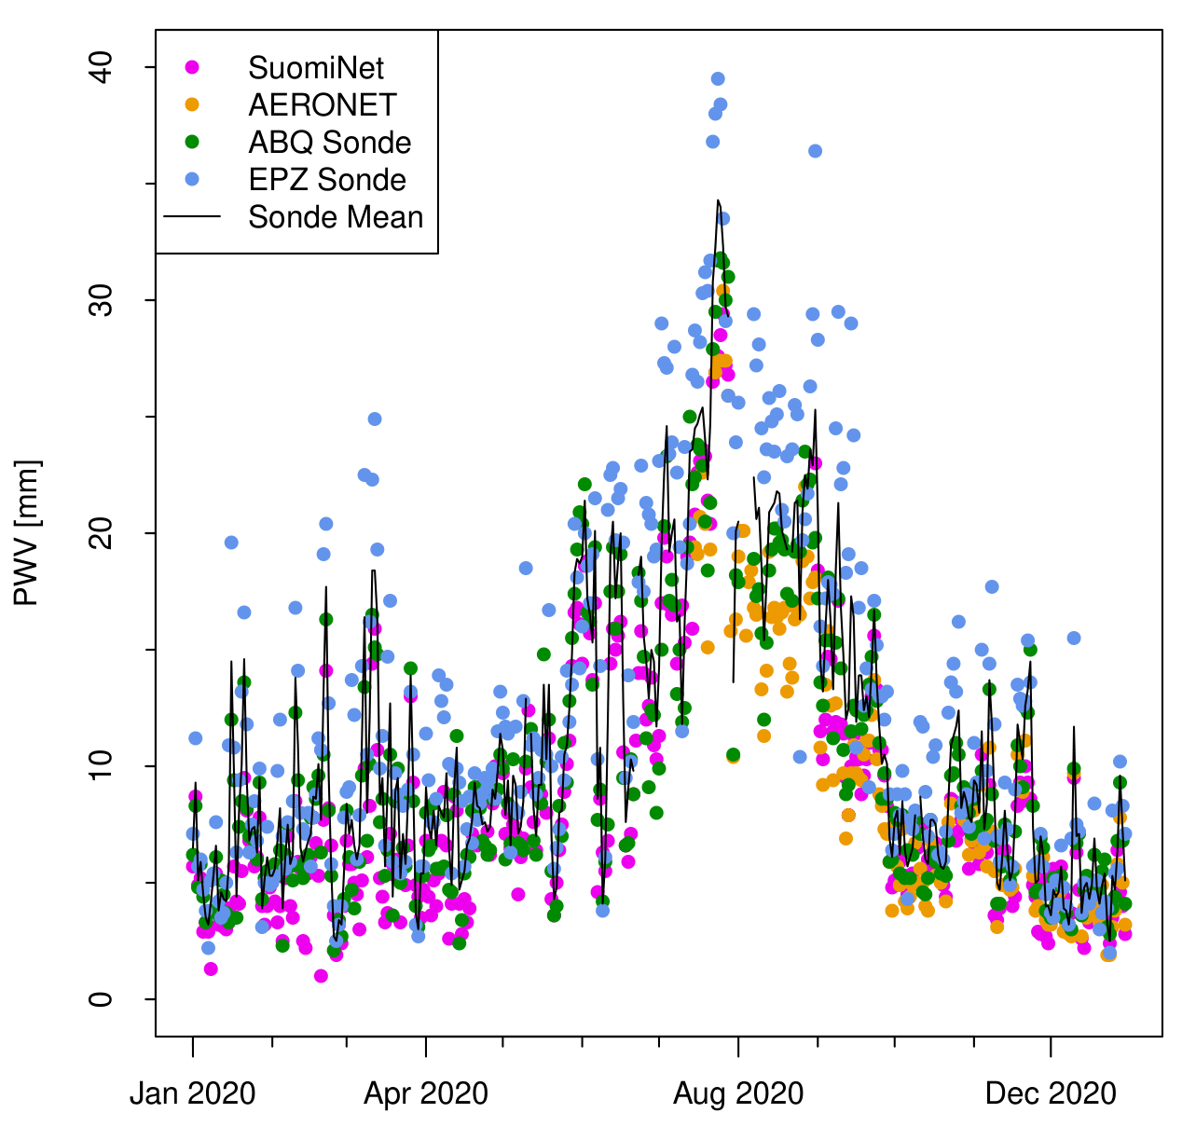
Local PWAT measurement comparisons
SC01 SuomiNet
- On M Mountain
- Satellite GPS
- ~2600 ft difference in elevation - Not online ~50% of the time since Jan 2019
AERONET
- Sevilleta National Wildlife Refuge
- Sun Photometer
- 22 miles north
- similar elevation
- online 5 months/year
(Kelsey et al., 2022)

Slide 9
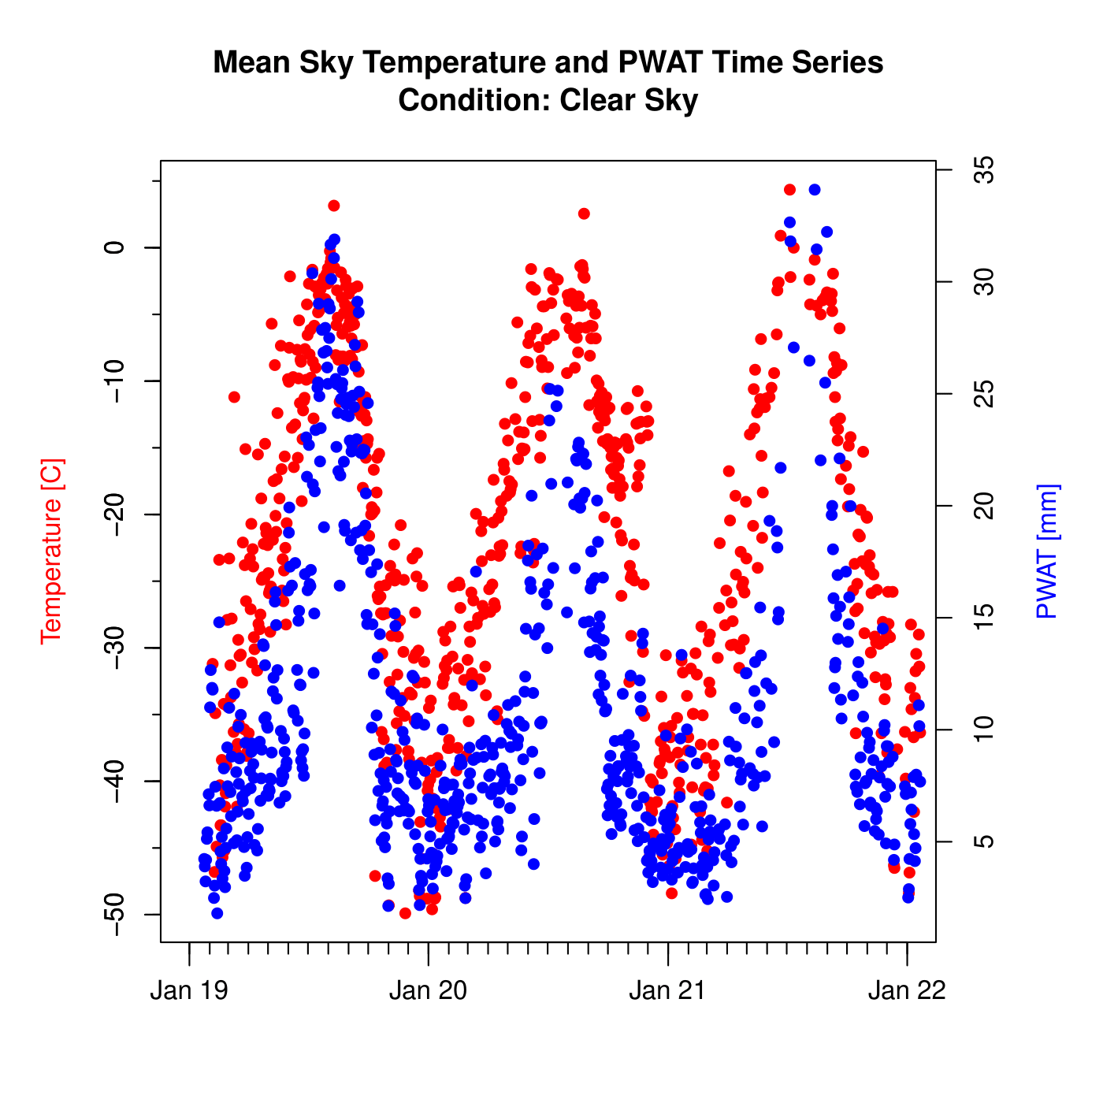
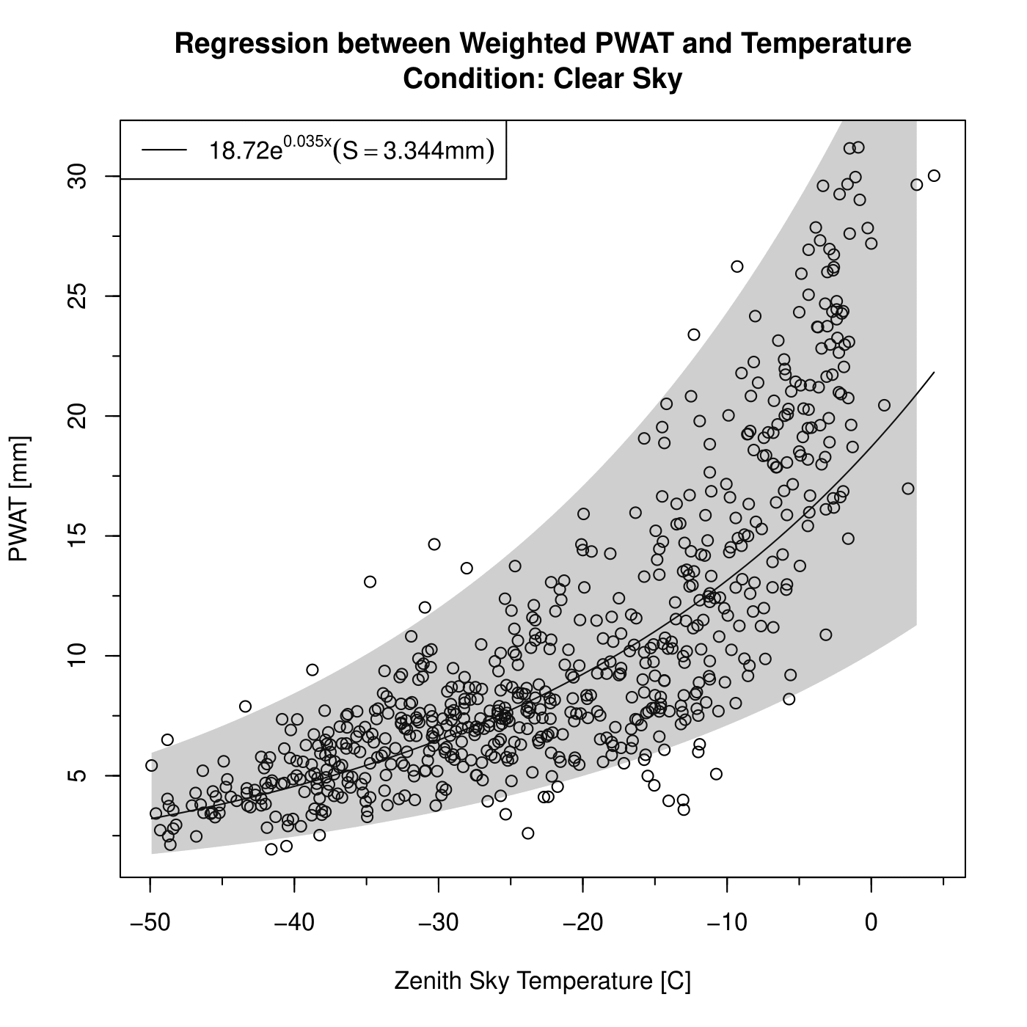
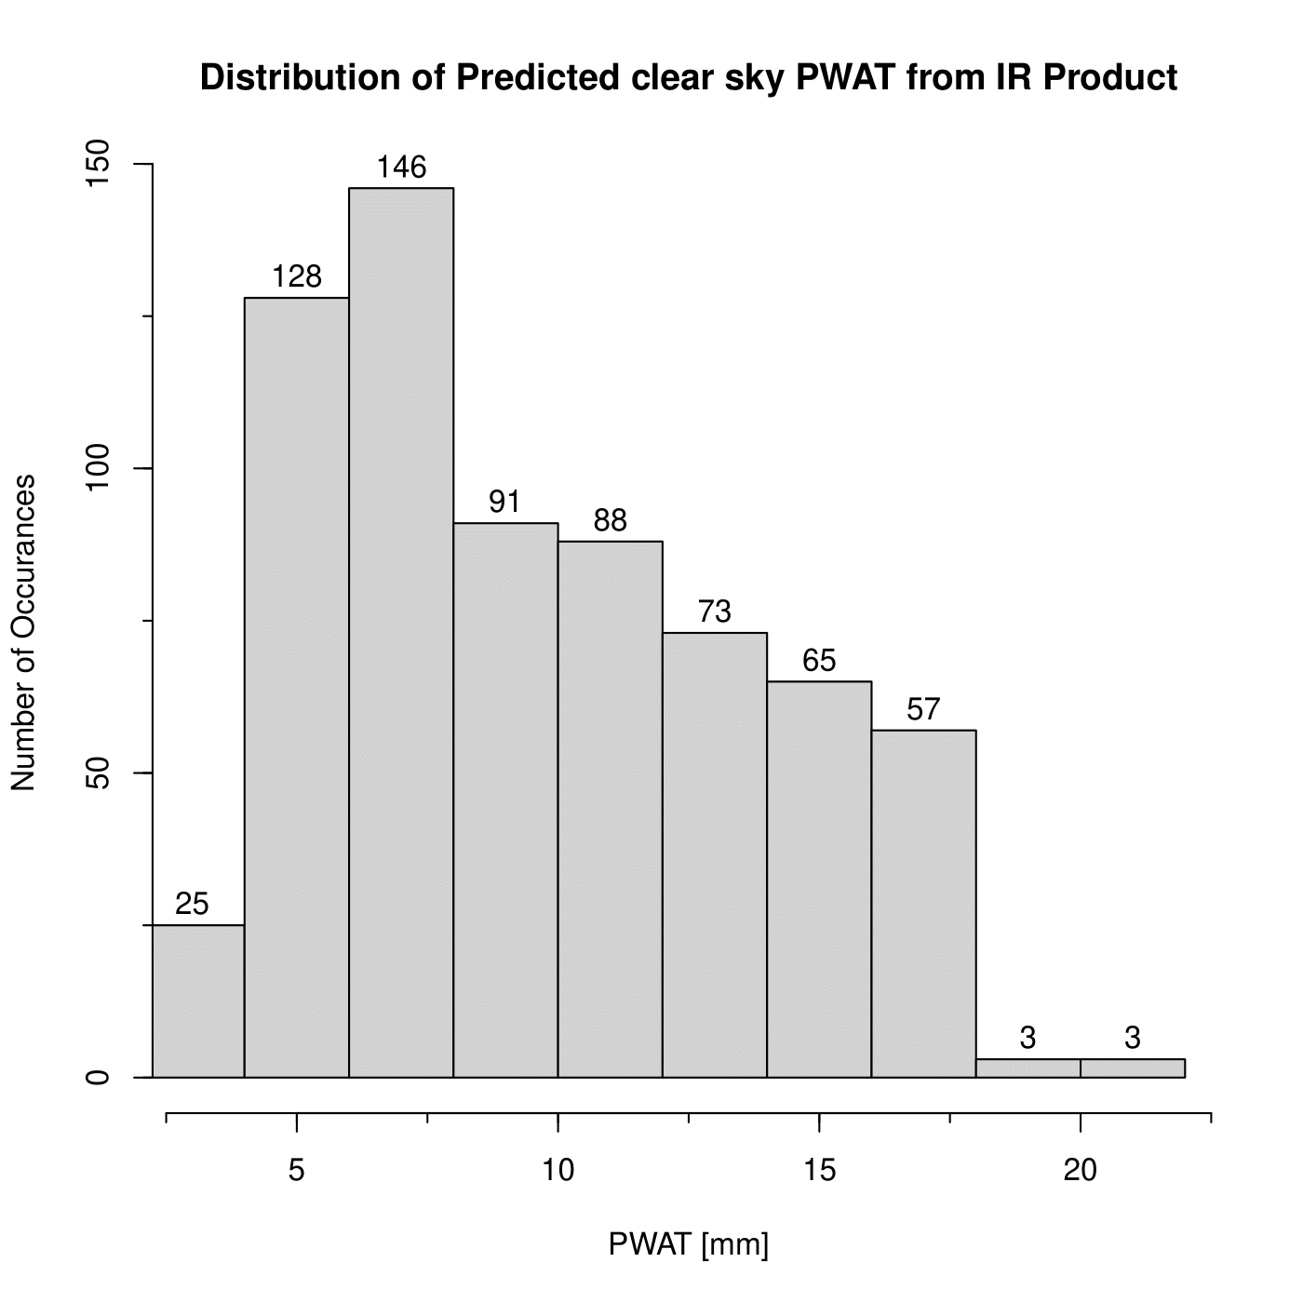
Approximation based on Correlation
Seasonal Trends
Spatiotemporal average with best-fit line
Correlation proved first, then PWAT values approximated
If GPS based satellite readings or POES data is available, it should be used
Approximation provides insight where there are no PWAT measurements available

Slide 10

Next steps
Automation
- Have measurements taken on an
hourly basis to be useful to NWS
Citizen Science / GLOBE Project
- Manual measurements at rural
locations
Data
- Automated Surface Observing
System (ASOS)
- Advanced Weather Interactive
Processing System (AWIPS)
Continued development of PMAT
- Open source software
- Full access to our dataset
https://docs.pmat.app/

Slide 11
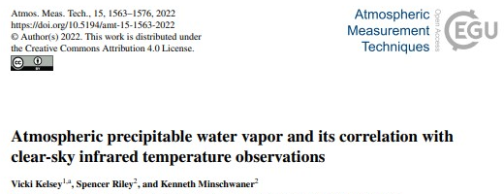

Any Questions?
Thanks for coming and hearing about the Precipitable Water Project today!
For more info, please see our paper (published 18 March 2022)
Vicki Kelsey
vkelsey@pmat.app
Spencer Riley
sriley@pmat.app
Kenneth Minschwaner
kminschwaner@pmat.app

